Slide 1


Become a Financial Aid Superhero with RMASFAA’s Best Practices
retrieved from: http://faithsmessenger.com/super-heroes/

Slide 2
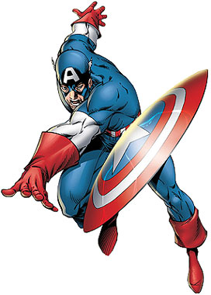
FSA ID
retrieved from: http://maditsmadfunny.wikia.com/wiki/Captain_America

Slide 3

Questions to which you’ll need to know the answer in a flash:
What is the FSA ID and what is it for? – Username and password used by students, parents, and borrowers to login to Dept. of Ed websites and electronically sign documents. (Replaces PIN)
You will use it to:
Apply for federal student aid every year www.fafsa.gov
To receive a federal student loan (MPN, Entrance Counseling).
To perform important activities as a federal loan borrower, such as choosing a repayment plan or applying for deferment.
Does my parent need one? - If you are a dependent student, then your parent will need an FSA ID in order to sign your FAFSA electronically.
IMPORTANT:
You and your parent must have different FSA IDs.
You must create your own!
Your parent must create ONLY their own!
You must use separate e-mails (you must each use your own e-mail address, two IDs cannot be under the same e-mail address).
retrieved from: https://www.walldevil.com/7214-blo0p-flash-superhero-minimalistic-red-background-superheroes.html

Slide 4

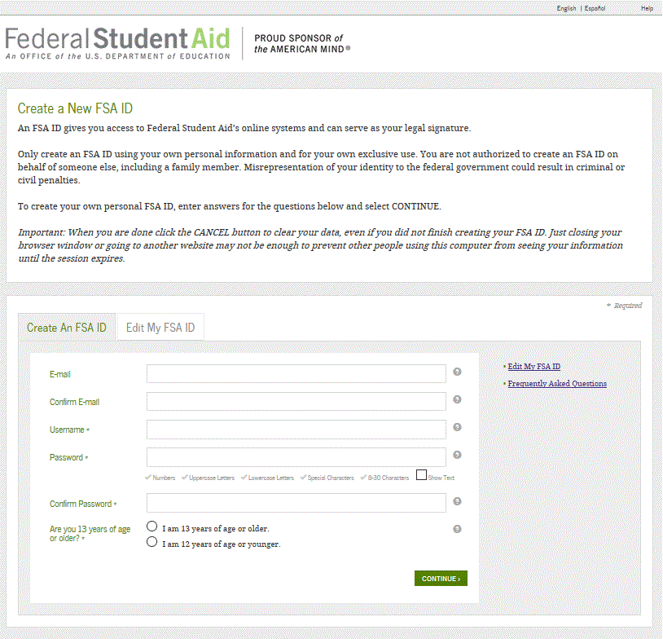
Best Practices when Creating an FSA ID:
www.fsaid.ed.gov
Familiarize yourself with the FSA ID website
Write EVERYTHING down and keep in a safe place
E-mail:
Applicant must have access to this e-mail account because FSA-ID@ed.gov will email an authorization code to applicant to establish the FSA ID.
Username:
Don’t include personal information such as Date of Birth (DOB) or name.
If you get a message “Username taken, create a different username” then someone has already taken that username. Must create a different name.
Always select “Show Text” to ensure accuracy
retrieved from: http://www.duup.co.uk/x/b694c75fbd

Slide 5

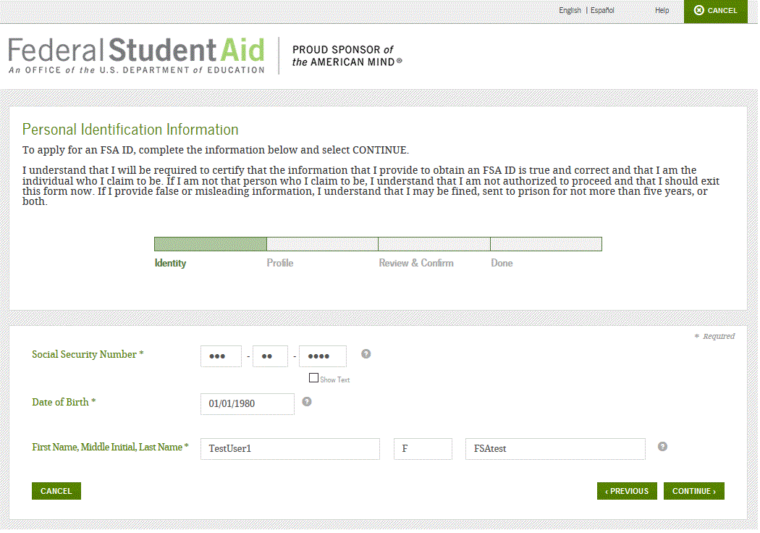
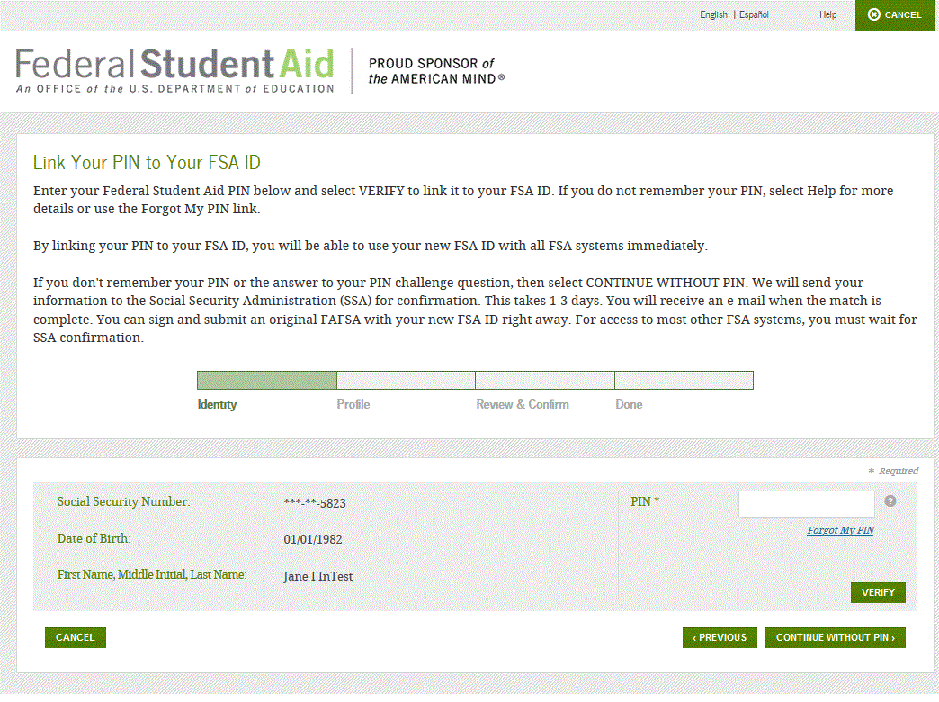
Personal Identification Information:
Make sure your Social Security Number (SSN), DOB, and Name match EXACTLY what is on your Social Security Card.
You MUST have a SSN to create an FSA ID.
If you applied for federal student aid before May 2015, then you most likely had a 4-digit PIN - you can link your PIN to your FSA ID on this screen.
If you can’t remember your PIN, you can select “Forgot My PIN” and answer a challenge question or you can continue without linking your PIN.
Link Your PIN (if you have one)
If you never had a PIN, you won’t get this screen
Background retrieved from: http://storagetopia.imation.com/en/storagehero/

Slide 6

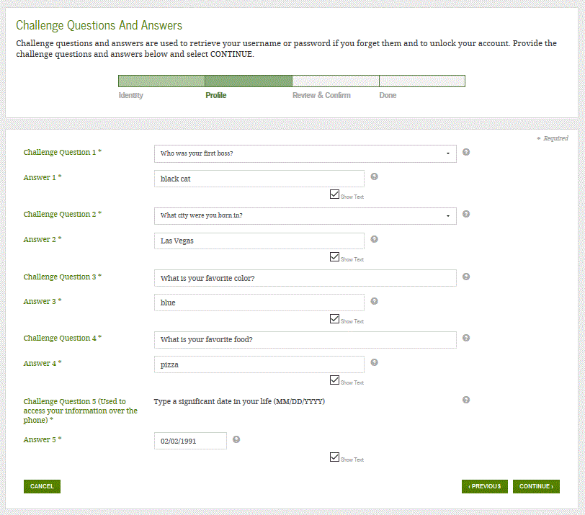
Challenge Questions
Answering your challenge questions is one way to unlock your account or reset your username and password
Questions 1 and 2:
Select a question from the dropdown menu and then enter your answer
Questions 3 and 4:
Make up your own question and enter your answer
Make sure the answers will be easy to remember
It can’t have the same answer as a previous question or contain any of your personal identification information.
Question 5:
Enter a significant date
It can’t be your date of birth
Examples of dates:
Favorite holiday
Sibling or parent date of birth
Always
“Show Text”
retrieved from: http://www.wallpaperup.com/138213/DAREDEVIL_marvel_superhero_gq.html

Slide 7

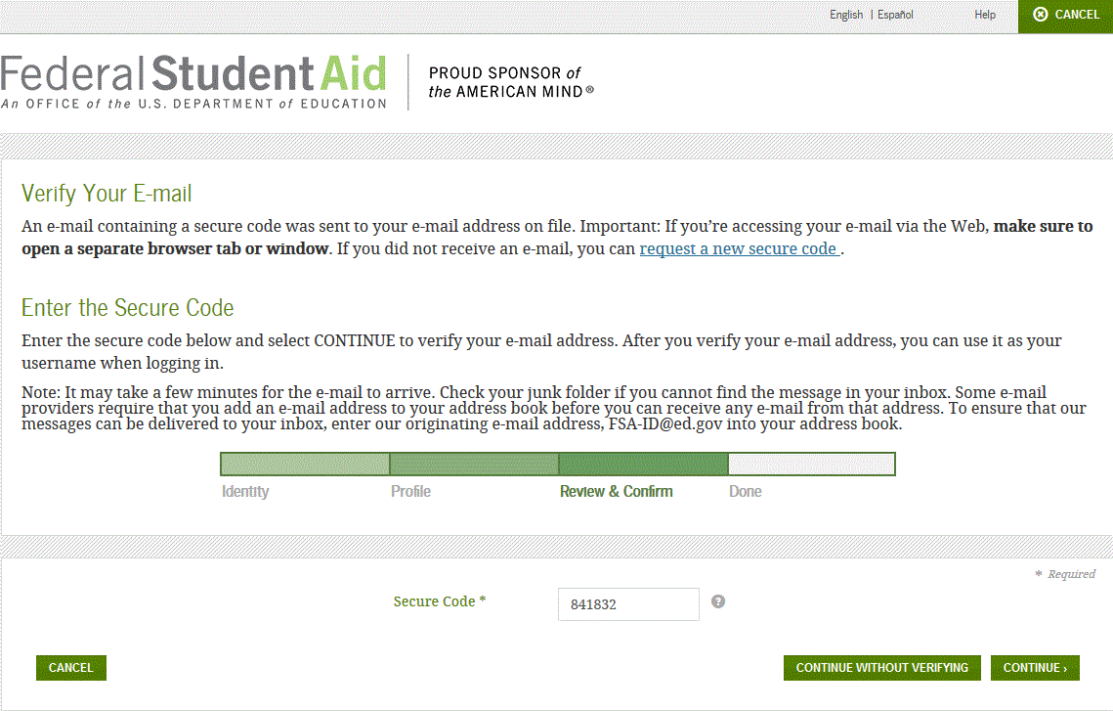
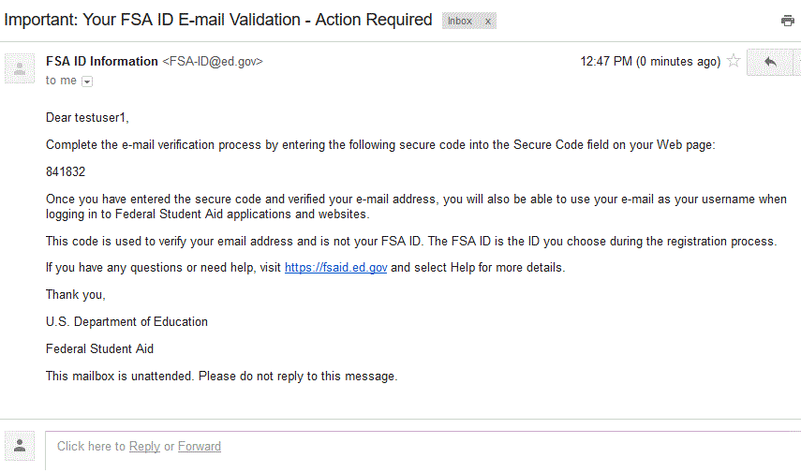
Verify Your E-mail
E-mail Verification Page
Once you verify your e-mail, you can use your e-mail address as your username when logging in to Department of Education websites
How to Verify Your E-mail
Do not close the E-mail Verification page
FSA-ID@ed.gov sends an e-mail with a secure code
Log in to your e-mail account using a different tab or browser window or another device
Look for an e-mail with the subject line, “Important: Your FSA ID E-mail Validation - Action Required”
The e-mail will include a six-digit, numeric code that you will enter in the “Secure Code” data field
E-mail With Your Secure Code
retrieved from: http://wallup.net/superhero-marvel-cinematic-universe-marvel-heroes-deadpool-blo0p/

Slide 8

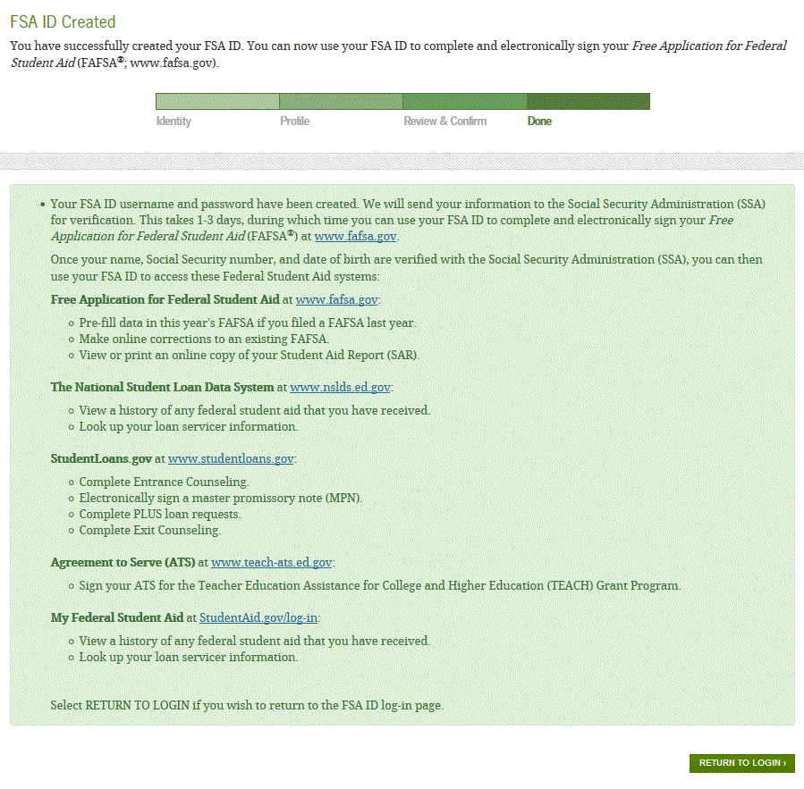
The FSA ID is Created…Now What?
You can log in to fafsa.gov and complete, sign, and submit a new (original) FAFSA
If you didn’t provide or link to a PIN, then your info will be sent to the Social Security Administration for confirmation
SSA review will take 1-3 days
Until your info is verified, you won’t be able to take certain actions, such as correct your FAFSA, submit a renewal FAFSA, or sign a Master Promissory Note.
You should receive an e-mail informing you of the results of the SSA review
If there is an issue, log in at FSAID.ed.gov using the “Edit My FSA ID” tab and review/update your profile info.
If your information is correct, you’ll need to contact the SSA (to find your local SSA office, call 1-800-772-1213 or go to www.ssa.gov)
retrieved from: http://www.wallconvert.com/converted/green-lantern-a-superhero-green-minimalism-231436.html

Slide 9

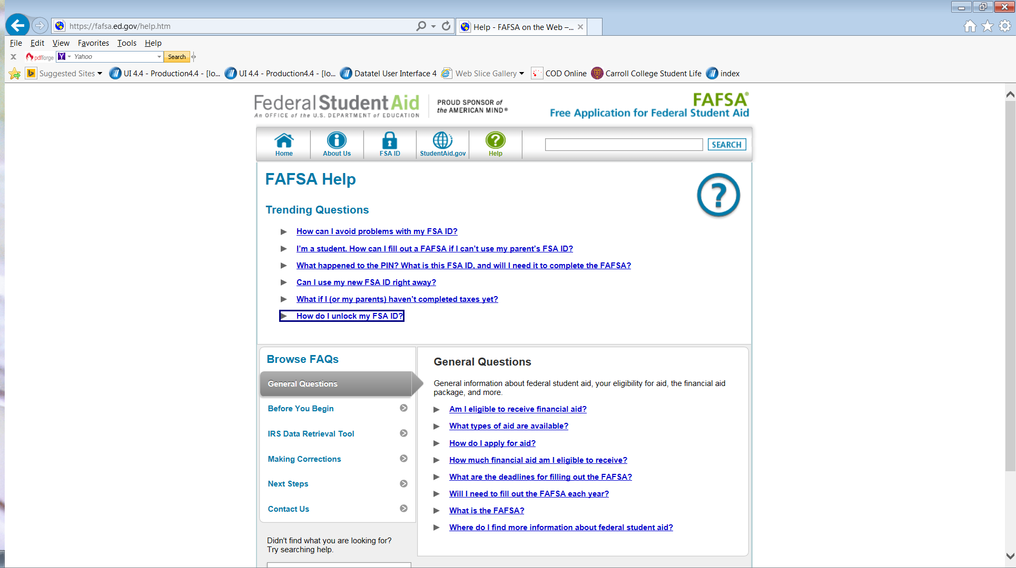
Know your Resources:
https://fafsa.ed.gov/help.htm
Know the Answers to Common Questions:
How can I avoid problems with my FSA ID?
How can I fill out a FAFSA if I can’t use my parent’s FSA ID?
What happened to the PIN?
Can I use my FSA ID immediately?
And the most important answer…
How do I unlock the FSA ID?
Use the Financial Aid Toolkit
http://www.financialaidtoolkit.ed.gov/tk/search#YourSearchResults
http://wallup.net/simple-background-superhero-comics-heroes-hellboy-dark-horse-blo0p-minimalism/

Slide 10
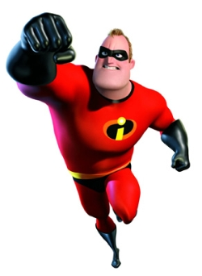

Create Awareness Campaigns on Campus about the new FSA ID Changes
Highlight tips
on your
website
www.carroll.edu/finaid/fafsa.cc
Logo retrieved from: https://commons.wikimedia.org/wiki/File:Symbol_from_The_Incredibles_logo.svg
Mr. Incredible retrieved from: http://www.prisoncensorship.info/archive/etext/movies/long/incredibles.html

Slide 11

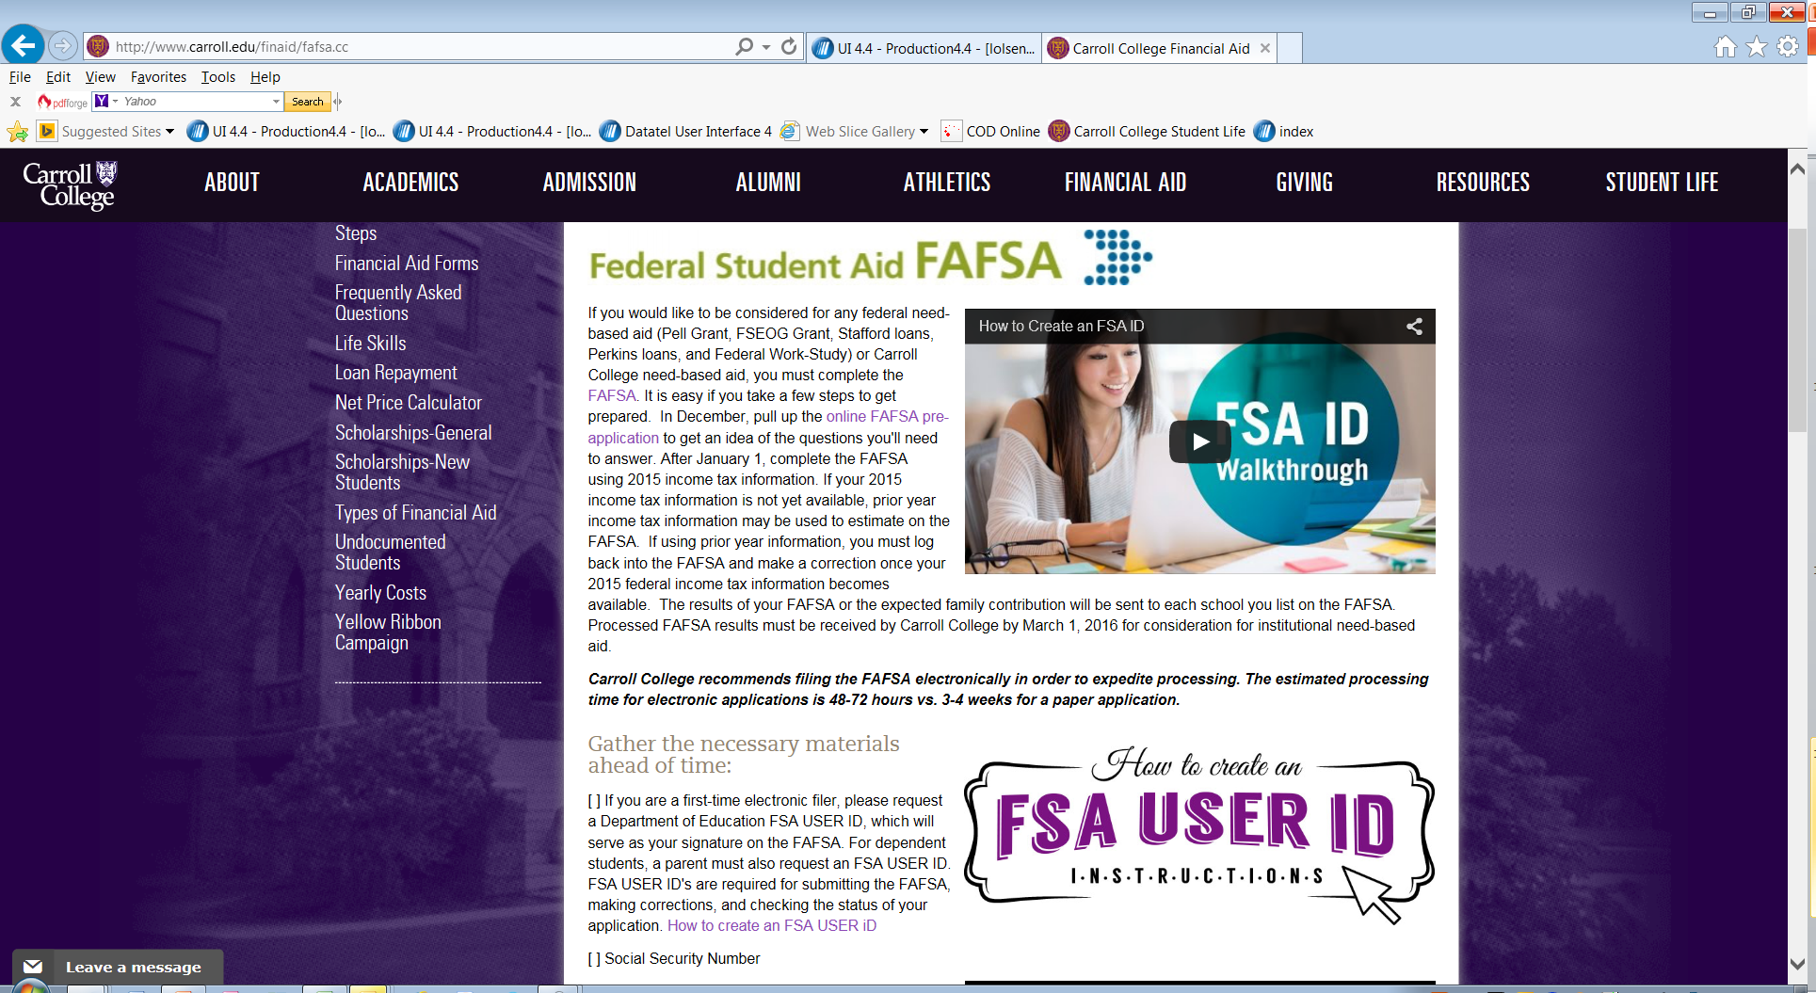
Creating awareness continued…
11
Retrieved from: http://videohive.net/item/superhero-background-/7931081
www.carroll.edu/finaid/fafsa.cc

Slide 12

Professional
Judgment
retrieved from: http://cartoonfatness.wikia.com/wiki/Superman

Slide 13

Who/What Gives Us the Authority?
HEA Sec. 479A(a) IN GENERAL—Nothing in this part shall be interpreted as limiting the authority of the financial aid administrator, on the basis of adequate documentation, to make adjustments on a case-by-case basis to the cost of attendance or the values of the data items required to calculate the expected student or parent contribution (or both) to allow for treatment of an individual eligible applicant with special circumstances. However, this authority shall not be construed to permit aid administrators to deviate from the contributions expected in the absence of special circumstances.
retrieved from: http://wallup.net/green-arrow-minimalism-green-background-blo0p-superhero-dc-comics/

Slide 14

Villainous PJ Pitfalls
DO NOT make general PJ adjustments to a class or group of students.
DO NOT modify the formula or the tables used in the EFC calculation or adjust COA data elements just because you believe they are inadequate.
DO NOT use PJ to waive general student eligibility requirements.
DO NOT make unreasonable judgments.
DO NOT forget about the Income Protection Allowance.
DO NOT use newly adjusted EFC for Pell and old EFC for other aid eligibility.
retrieved from: http://wallpapershidef.com/joker-pictures-cartoon-2.html

Slide 15

Professional Judgment
Best Practices
Knowing what constitutes a PJ
Policies and Procedures - Forms
Knowing who has the authority
Identification
Consistency and Documentation are KEY
Establishing a good way to track PJs
retrieved from: http://coldslitherpodcast.com/2013/03/08/10-comic-book-women-we-admire/

Slide 16

Things to Remember about pj:
Take your emotions out of it.
Document, document, document!
Take every opportunity to learn.
Always case-by-case, but remain consistent.
retrieved from: http://photobucket.com/images/batman%20symbol

Slide 17

Implications of PPY on Professional Judgment
GEN-16-03 Dear Colleague letter recently released stated:
“A professional judgment adjustment may be warranted if a family member experienced a significant change of income, either upward or downward. For example, for an individual who has lost a job or has taken a significant salary cut beginning in August of 2015, the FAA may use the income for the 12-month period following the reduction in income (September 2015 through August 2016) instead of the prior-prior year income (calendar 2015) that was initially used in the EFC calculation. Alternatively, the FAA may choose to use more recent income…”
Pros: We can get actual proof of earnings for a PJ because by August 2017, both ‘15 & ‘16 will have already passed and w-2s and paystubs will be available to compare. Confidence, accuracy, and good documentation.
Cons: More PJs to process. Potential need to consider 3 years of income (2015, 2016, and 2017) to determine if PJ is appropriate.
retrieved from: http://www.tutorialgeek.net/2011/04/ninja-turtlecolor-code-hartman.html

Slide 18

Use the force…and use it wisely
retrieved from: http://mamiverse.com/star-wars-quotes-philosophy-60809/

Slide 19

Work-Study:
Ways to Motivate
Student Participation
retrieved from: http://bobhertley.deviantart.com/art/Thor-430072542

Slide 20

Why Federal Work-Study?
Reduces the need for students to borrow as much in loans.
Gives them ‘real life’ experience to use on résumés.
Allows them to have a pay check while attending school.
Job works around class schedule.
Allows the student to build relationships and make connections which will later on benefit them.
retrieved from: http://wallpaperswide.com/iron_man_comic_art-wallpapers.html

Slide 21

Ways to encourage Faculty and Staff participation
Hold an informational session and invite anyone who has an interest in Student Employment or Work-Study options.
Request job descriptions from faculty and staff.
Hold a meeting for all new supervisors
and train on policies, how to hire, etc.
Always be there to assist them along the way!
retrieved from: http://trendsnow.deviantart.com/

Slide 22

Ways to promote Student participation
Make the application process as easy and seamless as possible
Have current students wear T-shirts to advertise that they have a student employment job.
Hold a job fair at the beginning of the year.
Provide Federal Work-Study (FWS) or other student employment as a part of the student’s total financial aid award.
Reach out to organizations outside of the college to offer more opportunities for students.
Make the jobs easily available for students to view (i.e. portal, job board)
retrieved from: http://batcatpodcast.blogspot.com/2012/11/joltin-john-dimaggio.html

Slide 23

Ways to increase work-study success
Communicate with student employment supervisors as much as you can (surveys, e-mails, newsletters).
Ask supervisors and students what worked and what didn’t.
Evaluations – both from supervisors and students.
Celebrate your student workers during student employment appreciation week/month.
Recognize students who excel in their position.
If you can, give raises to those who are doing a great job.
retrieved from: http://www.bigsparkmedia.com/blog/56-hip-hip-hooray-for-the-underdog-how-small-business-packs-a-punch

Slide 24

Work-Study Best practices
Keep lines of communication open and flowing with the HR department.
Allow student employees to actually assist and work in their jobs. There’s more to a job than filing and shredding.
Keep them involved and active in your area.
Don’t request X amount of hours if you do not have enough work for the student to complete.
Follow your job descriptions and update them as often as needed.
retrieved from: http://comicvine.gamespot.com/images/1300-4530185

Slide 25

Prior-prior
year
retrieved from: http://cartoonfatness.wikia.com/wiki/Wonder_Woman

Slide 26

President Obama authorized September 13, 2015
October 1st – FAFSA Start-up
Use of “Prior-Prior” Year Income Data
Starting with 2017-2018 FAFSA
Will be available October 1, 2016
Based on 2015 Tax Income
Background
**We will have two FAFSA years that will be based on 2015 income!!
retrieved from: https://www.pinterest.com/pin/509399407826137391/

Slide 27
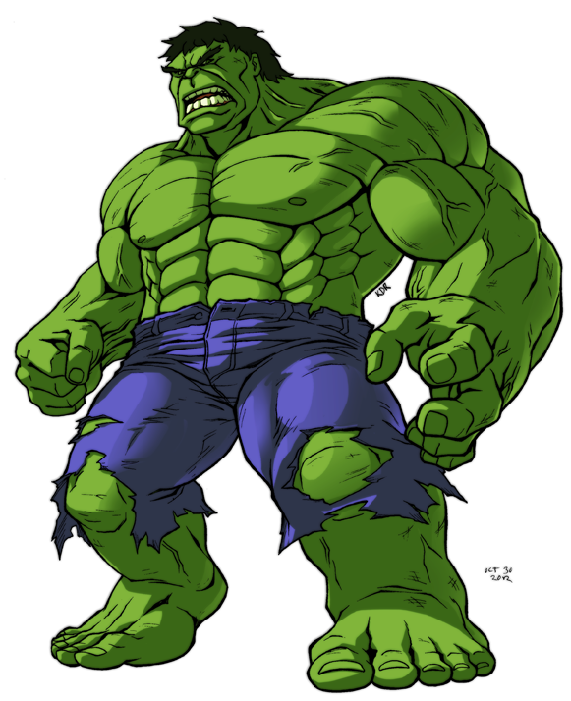
Outreach – Spreading the Word
Handling an increase of Professional Judgments
Impact on Verifications
Managing Conflicting Information
retrieved from: http://machsabre.deviantart.com/art/Hulk-337679078
Implications for our offices

Slide 28


More Implications for our offices
Financial Aid Systems – Ensure our vendors are ready.
State Impact – Foreseeable actions we can take.
College Impact – Making sure your school is prepared to process earlier.
retrieved from: http://marvel.com/news/movies/24758/sony_pictures_and_marvel_studios_find_their_spider-man_star_and_director

Slide 29

resources
Early FAFSA Resources
http://ifap.ed.gov/EarlyFAFSA/EarlyFAFSAResources.html
Early FAFSA - Webinars and Presentations
http://ifap.ed.gov/EarlyFAFSA/EarlyFAFSATraining.html
Early FAFSA – Dear Colleague Letters and Electronic Announcements
http://ifap.ed.gov/EarlyFAFSA/EarlyFAFSADCLandEA.html
IFAP – Early FSA Electronic Announcement #1 – President’s Announcement of FAFSA Filing Changes
IFAP – Early FSA Electronic Announcement #2 – Preparing for 2017-2018 Early FAFSA and Prior-Prior Year
IFAP – Early FAFSA Electronic Announcement #3 - Availability of the 2017-2018 Early FAFSA Information Page on the Information
for Financial Aid
Professionals (IFAP)
website
retrieved from: http://123hdwallpapers.com/x-men-wolverine-yellow-marvel-comics-cartoon.html#.Vs9RBvkrKUk

Slide 30

resources
continued
April 2016 – FSA will share
17-18 FAFSA materials via
Financial Aid Toolkit-
www.financialaidtoolkit.ed.gov
-Updated Videos
-Updated Publications
-Social Media Information
Outreach to students and parents (social media, in-person events, webinars)
StudentAid.gov will include updated information
Partnership with schools, states, etc. to share message with students and parents
Mid-August 2016 – FSA will
launch 17-18 FAFSA
Integrated Communications
Campaign
Retrieved from http://paper4pc.com/cartoons/4/

Slide 31
Resource References
Federal Application for Federal Student Aid (slide 3) – www.fafsa.gov
FSA ID Website (slide 4) – www.fsaid.ed.gov
Social Security Administration Information (slide 8) – www.ssa.gov
FAFSA Help (slides 9) - https://fafsa.ed.gov/help.htm
Financial Aid Toolkit (slides 9 & 15) - http://www.financialaidtoolkit.ed.gov/tk/search#YourSearchResults
President Obama: Feds to Allow Use of Prior-Prior Year Income Data on the FAFSA Starting in 2017-18 School Year (slide 12) - https://www.nasfaa.org/ppy_nasfaa_press_release
Early FAFSA Electronic Announcement #1 – President’s Announcement of FAFSA Filing Changes (slide 15) - https://ifap.ed.gov/eannouncements/091415PresidentAnnounceFAFSAFilingChanges.html
Early FAFSA Electronic Announcement #2 – Preparing for 2017-2018 Early FAFSA and Prior-Prior Year
(slide 15) - https://ifap.ed.gov/eannouncements/021816EarlyFAFSAEA2andPriorPriorYear.html
Prior-Prior Year Updated Information (slide 15) – www.studentaid.gov
GEN-16-03 Dear Colleague Letter PJ and PPY (slide ) - https://ifap.ed.gov/dpcletters/GEN1603.html
FSA ID Website Awareness examples (slide ) - www.carroll.edu/finaid/fafsa.cc
Professional Judgment definition (slide ) - https://www.ifap.ed.gov/fsahandbook/attachments/1516FSAHbkActiveIndexMaster.pdf

Slide 32
Superhero Works Cited:
Superhero Background (Cover Slide) retrieved from: http://faithsmessenger.com/super-heroes/
Batman Theme clip (cover slide) retrieved from: http://www.wavsource.com/tv/batman.htm
Captain America (slide 2) retrieved from: http://maditsmadfunny.wikia.com/wiki/Captain_America
The Flash Backdrop (slide 3) retrieved from: https://www.walldevil.com/7214-blo0p-flash-superhero-minimalistic-red-background-superheroes.html
Robin wallpaper (slide 4) retrieved from: http://www.duup.co.uk/x/b694c75fbd
Cityscape Background (slide 5) retrieved from: http://storagetopia.imation.com/en/storagehero/
Daredevil Wallpaper (slide 6) retrieved from: http://www.wallpaperup.com/138213/DAREDEVIL_marvel_superhero_gq.html
Deadpool Wallpaper (slide 7) retrieved from: http://wallup.net/superhero-marvel-cinematic-universe-marvel-heroes-deadpool-blo0p/
Green Lantern Wallpaper (slide 8) retrieved from: http://www.wallconvert.com/converted/green-lantern-a-superhero-green-minimalism-231436.html
Hellboy Background (slide 9) retrieved from: http://wallup.net/simple-background-superhero-comics-heroes-hellboy-dark-horse-blo0p-minimalism/
Incredibles Logo (slide 10) retrieved from: https://commons.wikimedia.org/wiki/File:Symbol_from_The_Incredibles_logo.svg
Superhero Background (slide 11) retrieved from: http://videohive.net/item/superhero-background-/7931081
Wonder Woman (slide 12) retrieved from: http://cartoonfatness.wikia.com/wiki/Wonder_Woman
City Backdrop (slide 13) retrieved from: https://www.pinterest.com/pin/509399407826137391/
The Incredible Hulk (slide 14) retrieved from: http://machsabre.deviantart.com/art/Hulk-337679078
Spiderman (slide 15) retrieved from: http://marvel.com/news/movies/24758/sony_pictures_and_marvel_studios_find_their_spider-man_star_and_director Wolverine X-men (slide 16) retrieved from: http://123hdwallpapers.com/x-men-wolverine-yellow-marvel-comics-cartoon.html#.Vs9RBvkrKUk
Wolverine X-ment (slide 17) retrieved from: http://paper4pc.com/cartoons/4/
Superman (slide 18) retrieved from: http://cartoonfatness.wikia.com/wiki/Superman
Green Arrow Background (slide 19) retrieved from: http://wallup.net/green-arrow-minimalism-green-background-blo0p-superhero-dc-comics/
The Joker (slide 20) retrieved from: http://wallpapershidef.com/joker-pictures-cartoon-2.html
X-Men Jean Grey (slide 21) retrieved from: http://coldslitherpodcast.com/2013/03/08/10-comic-book-women-we-admire/
Batman symbol (slide 22) retrieved from: http://photobucket.com/images/batman%20symbol
Teenage Mutant Ninja Turtle Leonardo (slide 23) retrieved from: http://www.tutorialgeek.net/2011/04/ninja-turtlecolor-code-hartman.html
Star Wars Yoda and Luke (slide 24) retrieved from: http://mamiverse.com/star-wars-quotes-philosophy-60809/
Thor (slide 25) retrieved from: http://bobhertley.deviantart.com/art/Thor-430072542
Iron Man wallpaper (slide 26) retrieved from: http://wallpaperswide.com/iron_man_comic_art-wallpapers.html
Storm X-Men (slide 27) retrieved from: http://trendsnow.deviantart.com/
Aquaman (slide 28) retrieved from: http://batcatpodcast.blogspot.com/2012/11/joltin-john-dimaggio.html
Underdog (slide 29) retrieved from: http://www.bigsparkmedia.com/blog/56-hip-hip-hooray-for-the-underdog-how-small-business-packs-a-punch
Superhero wallpaper (slide 30) retrieved from: http://comicvine.gamespot.com/images/1300-4530185
Bat-time announcer clip (works cited slide) retrieved from: http://www.rosswalker.co.uk/tv_sounds/batman.htm

